Slide 1
Data Preparation Assignment
Data Science Course
Jigsaw user Id: veeranna.mh@gmail.com

Slide 2
Data Preparation Assignment
Approach:
data1 dataframe is same as original csv file
data2 dataframe after na.omit
data3 initiated as replica of data1 and then NAs of each variable are imputed with mean.
data4 is initiated as replica of data3 and NAs of minuse4 which were imputed with mean in data3 are replaced by medians (as indexes of NAs are known).
data5 is replica of data4, extreme outlier 177700 value replaced by median for minuse4.
data6 initiated as replica of data5 and two outliers of minuse3 are replaced by mean.

Slide 3
Data Preparation Assignment
Answers to questions:
How many variables have missing values (frequency distribution) : 7 variables
If all missing value records are deleted, what is the total loss of records?: 23 records
If you decide to update the missing values with mean, what is the impact on standard deviation of each variable? refer next slide
If you decide to impute missing values, how could you potentially impute minutes used4? : with median
How many outliers can you identify for each variable? :
Minuse1 : 1
Minuse2 : 1
Minuse3 : 2
Minuse4 : 1 (177700) and 2 after imputing largest outlier with median
If you replaced the top two extreme values by the mean for any one of the variables, how would the standard deviation change? : SD changes from 155.5 to 150

Slide 4
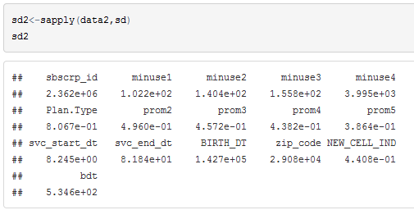
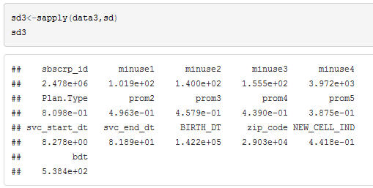
Data Preparation Assignment
SD has reduced slightly
(top table : NA records omitted.
bottom table: NA imputed with mean)

Slide 5
Thank you

